Slide 1
Firewalls
Corporate Computer Security, 4th Edition
Randall J. Boyle & Raymond R. Panko
Chapter 6

Slide 2
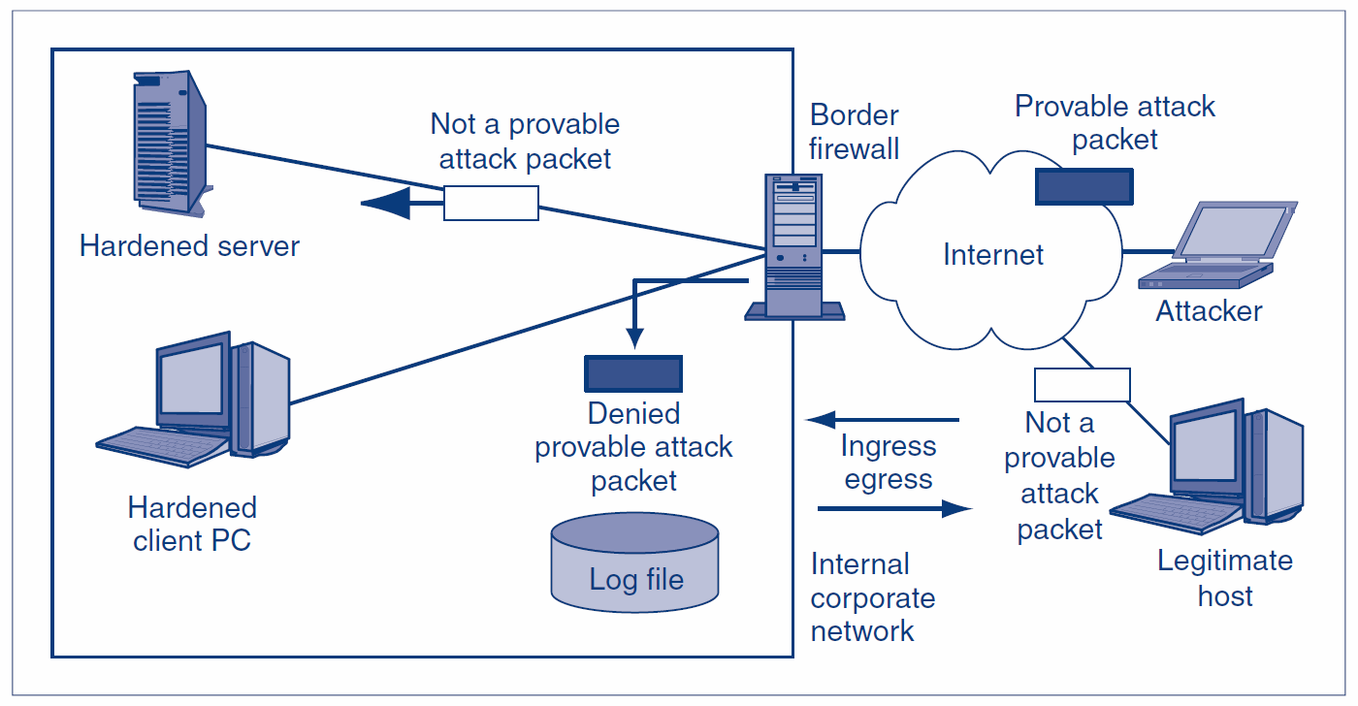
6.1: Basic Firewall Operation
1.
Legitimate hosts send innocent packets.
Attackers send attack packets.
2.
Ingress packets come into a site.
Egress packets go out from a site.
6-2

Slide 3
6.1: Basic Firewall Operation
Firewalls drop and log
provable attack packets
6-3

Slide 4
6.1: Basic Firewall Operation
Firewalls do not drop packets unless they are provably attack packets.
This means that some attack packets that are not provably attack packets get through the firewall.
6-4

Slide 5
6.1: The Danger of Traffic Overload
The Problem
  If a firewall cannot filter all of the traffic passing through it, it drops packets it cannot process
  This is secure because it prevents attack packets from getting through
  It creates a self-inflicted DoS attack by dropping legitimate traffic
6-5

Slide 6
6.1: The Danger of Traffic Overload
Firewall Capacity
  Firewalls must have the capacity to handle the incoming traffic volume
  Some can handle normal traffic but cannot handle traffic during heavy attacks
  They must be able to handle incoming traffic at wire speed—the maximum speed of data coming into each port
6-6

Slide 7
6.1: The Danger of Traffic Overload
Firewall Filtering Mechanisms
  There are many types
  We will focus most heavily on the most important firewall filtering method, stateful packet inspection (SPI)
  Single firewalls can use multiple filtering mechanisms, most commonly, SPI with other secondary filtering mechanisms
6-7

Slide 8
6.2: Static Packet Filtering
Static Packet Filtering
  This was the earliest firewall filtering mechanism
  Limits
    Examines packets one at a time, in isolation
    Only looks at some internet and transport headers
    Consequently, unable to stop many types of attacks
6-8

Slide 9
6.2: Static Packet Filtering
Static Packet Filtering Can Stop Certain Attacks Very Efficiently
  Incoming ICMP Echo packets and other scanning probe packets
  Outgoing responses to scanning probe packets
  Packets with spoofed IP addresses (e.g., incoming packets with the source IP addresses of hosts inside the firm)
  Packets that have non-sensical field settings, such as a TCP segment with both the SYN and FIN bits set
6-9

Slide 10
6.3: Stateful Packet Inspection (SPI)
Connections have distinct states or stages
Different states are subject to different attacks
Stateful firewalls use different filtering rules for different states
Connection Opening
State
Ongoing Communication
State
Connection Closing
State
6-10

Slide 11
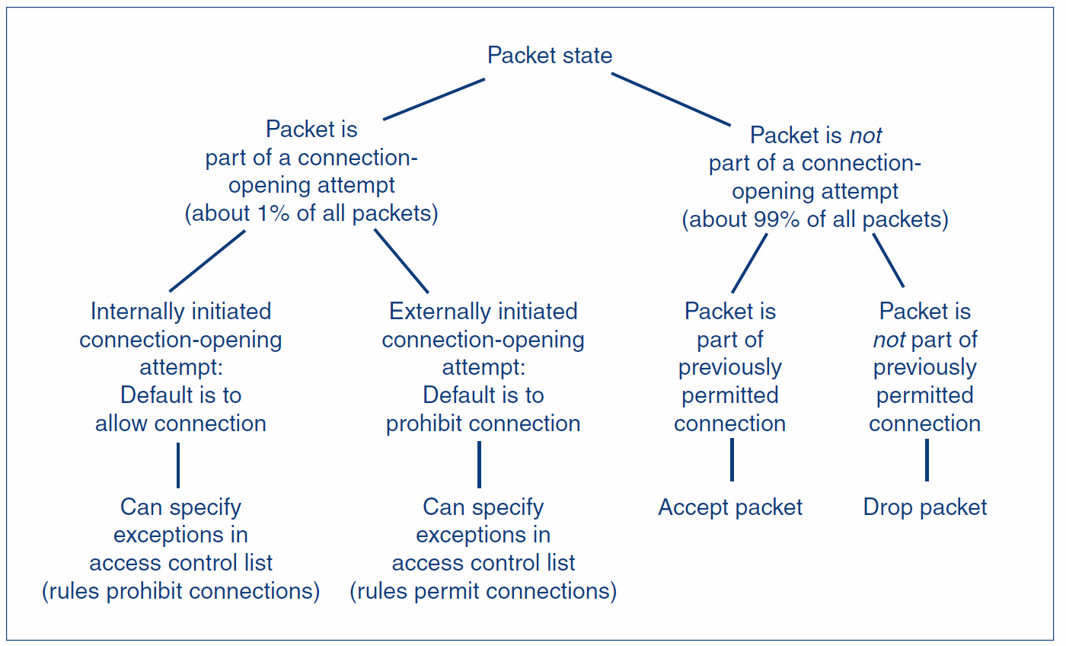
6.3: Stateful Inspection Rules with Two States
6-11

Slide 12
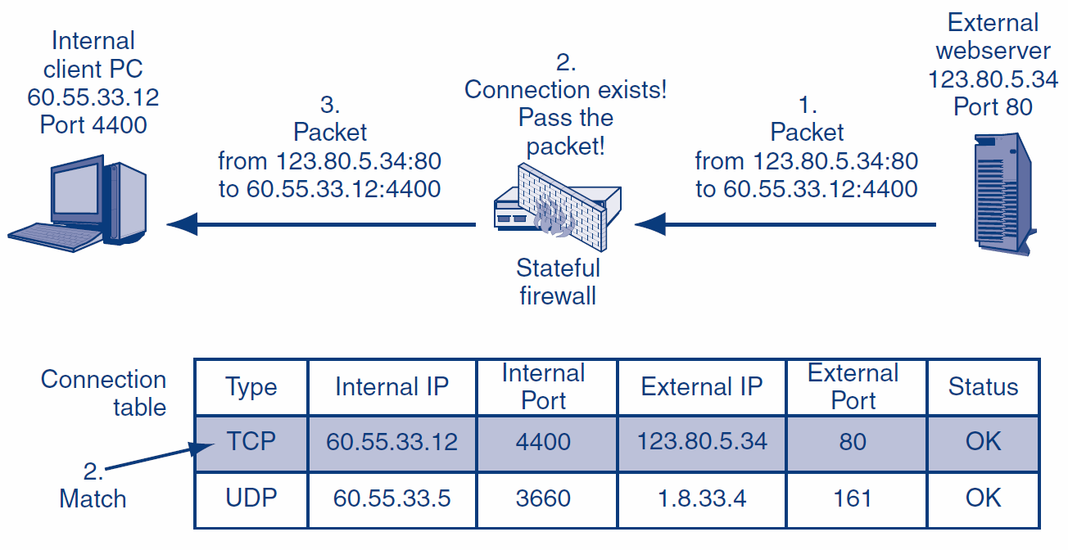
6.3: SPI for a Packet that Does Not Attempt to Open a Connection I
6-12
Notes:
The example here is for when the connection has already been established so there is an entry in the Connection table.

Slide 13
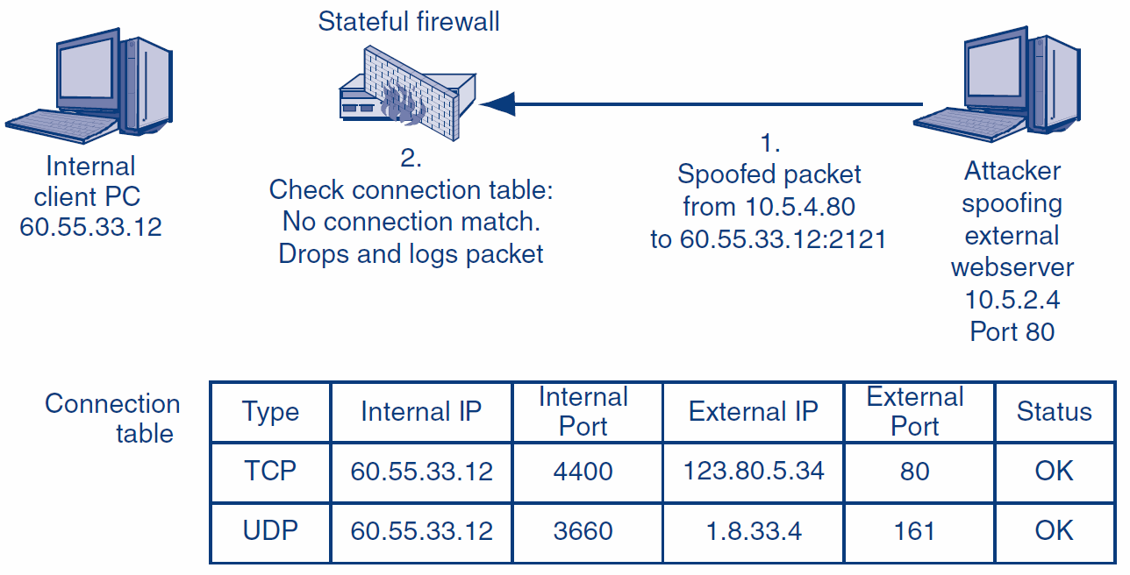
6.3: Stateful Packet Inspection for a Packet that Does Not Attempt to Open a Connection II
6-13

Slide 14
6.3: Ingress ACL in a SPI Firewall
Access Control List (ACL) Operation
  An ACL is a series of rules for allowing or disallowing connections
  The rules are executed in order, beginning with the first
    If a rule DOES NOT apply to the connection-opening attempt, the firewall goes to the next ACL rule
    If the rule DOES apply, the firewall follows the rule, and no further rules are executed
  If the firewall reaches the last rule in the ACL, it follows that rule
6-14

Slide 15
6.3: Ingress ACL in a SPI Firewall
Ingress ACL’s Purpose
  The default behavior is to drop all attempts to open a connection from the outside (why?)
  All ACL rules except for the last give exceptions to the default behavior under specified circumstances
  The last rule applies the default behavior to all connection-opening attempts that are not allowed by earlier rules to be executed by this last rule
6-15

Slide 16
6.3: Ingress ACL in a SPI Firewall
Simple Ingress ACL with Three Rules
  If TCP destination port = 80 or TCP destination port = 443, then Allow Connection
    [Permits connection to ALL internal webservers]
  If TCP destination port = 25 AND IP destination address = 60.47.3.35, then Allow Connection
    [Permits connections to a SINGLE internal mail server]
  Disallow ALL Connections
    [Disallows all other externally initiated connections; this is the default behavior]
6-16

Slide 17
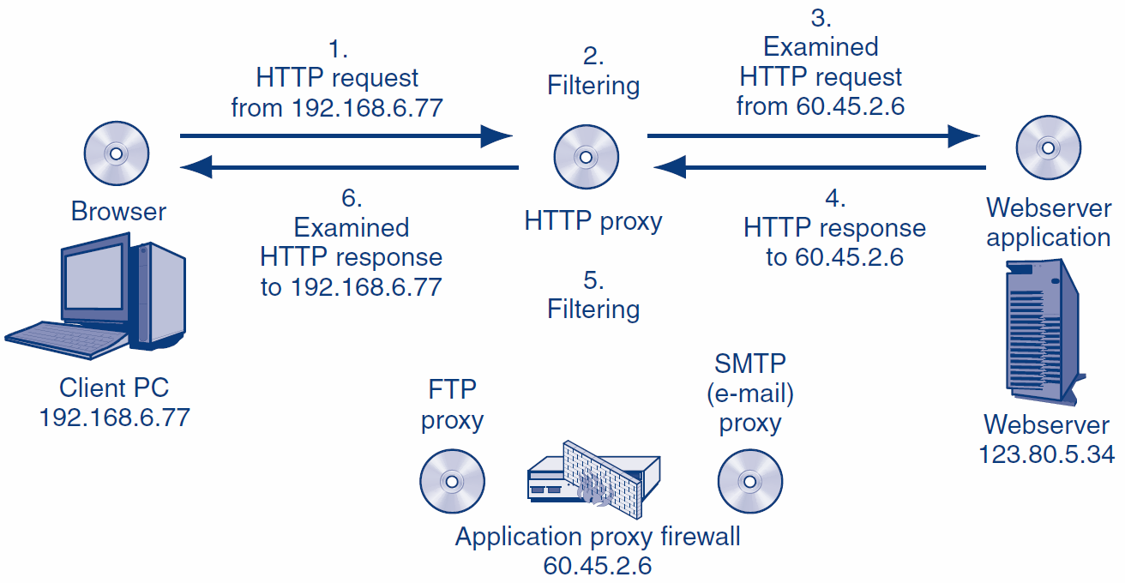
6.5: Application Proxy Firewall: Operation
https://www.youtube.com/watch?v=aUPoA3MSajU
6-17

Slide 18
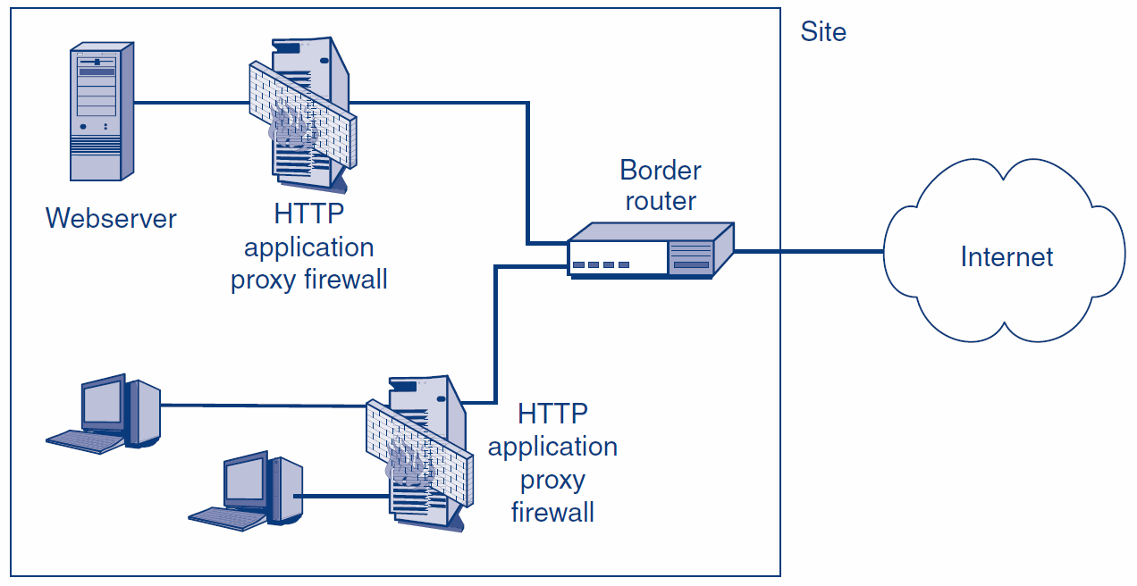
6.5: Roles for Application Proxy Firewalls Today
6-18

Slide 19
6.5: Application Proxy Firewall Protections
Protections for Internal Clients against Malicious Webservers
  URL blacklists for known attack sites
  Protection against some or all scripts in webpages
Protections against Misbehaving Internal Clients
  Disallowing the HTTP POST method, which can be use to send out sensitive files
6-19

Slide 20
6.5: Application Proxy Firewall Protections
Protections for Internal Webservers against Malicious Clients
  Disallow HTTP POST methods, which could allow malware files to be placed on the server
  Indications of SQL injection attacks
In computing, POST is a request method supported by HTTP used by the World Wide Web. By design, the POST request method requests that a web server accepts the data enclosed in the body of the request message, most likely for storing it. It is often used when uploading a file or when submitting a completed web form.
6-20

Slide 21
6.5: Application Proxy Firewall Protections
Automatic Protections
  The hiding of internal host IP addresses from sniffers
  Header destruction
    The data link, internet, and transport headers are discarded—along with any attacks they may have contained
  Protocol fidelity
    If the client or server does not follow the protocol of the indicated port number, communication with the firewall automatically breaks down
6-21

Slide 22
6.6: IDSs
Firewalls drop provable attack packets only
Intrusion detection systems (IDSs) look for suspicious traffic
  Cannot drop because the packet is merely suspicious
Sends an alarm message if the attack appears to be serious
6-22

Slide 23
6.6: IDSs: Problem
Too many false positives (false alarms)
  Alarms are ignored or the system is discontinued
  Can reduce false positives by tuning the IDSs
Heavy processing requirements because of sophisticated filtering
  Deep packet inspection
  Packet stream analysis
6-23

Slide 24
6.6: Intrusion Prevention Systems (IPSs)
Use IDS filtering mechanisms
Application-specific integrated circuits (ASICs) provide the needed processing power
6-24

Slide 25
6.6: IPSs
Attack confidence identification spectrum
  Somewhat likely
  Very likely
  Provable
Firm may allow firewall to stop traffic at the high end of the attack confidence spectrum
Firm decides which attacks to stop
This allows it to manage its risks
6-25

Slide 26
6.6: IPSs
Possible Actions
  Drop packets
    Risky for suspicious traffic even with high confidence
  Bandwidth limitation for certain types of traffic
    Limit to a certain percentage of all traffic
    Less risky than dropping packets
    Useful when confidence is lower
6-26

Slide 27
6.7: Unified Threat Management (UTM)
Unified Threat Management (UTM) Firewalls Go Beyond Traditional Firewall Filtering
  SPI
  Antivirus Filtering
  VPNs
  DoS Protection
  NAT
6-27

Slide 28
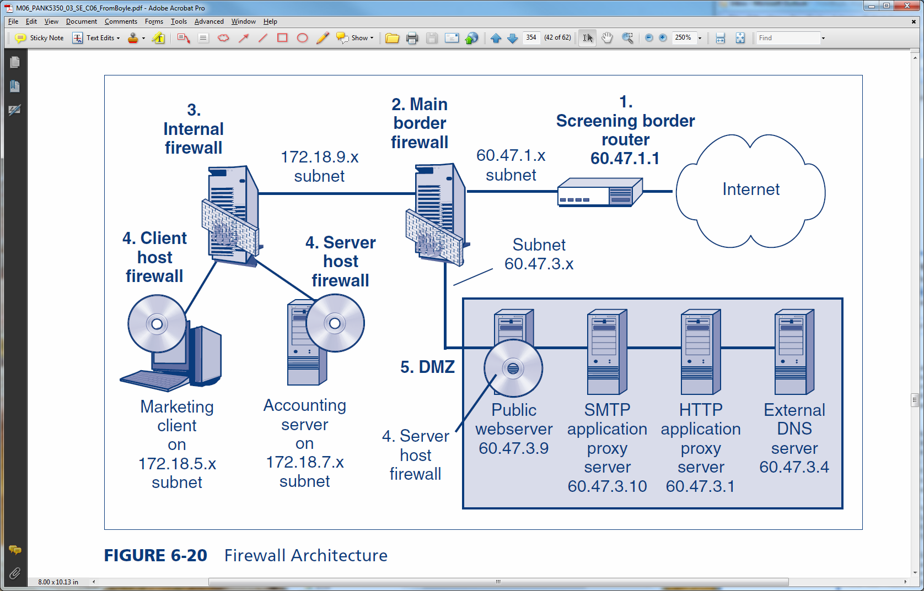
6.8: Firewall Architecture
A firm has many firewalls:
Screening border routers
Main border firewalls
Internal firewalls
Host firewalls on clients and servers
The firewall architecture describes
how these firewalls work together.
6-28
Notes:
Firewall architecture is responsible for the standards and frameworks associated with the architecture of sub-networks (aka subnets), which are a subdivision of an IP or TCP/IP network that exposes the company’s services to a larger untrusted network, such as the Internet.

Slide 29

6.8: The Demilitarized Zone (DMZ)
DMZs Use Multi-Homed
Main Firewalls
  One subnet to the
  border router
  One subnet to the DMZ (accessible to the outside world)
  One subnet to the internal network
    Access from the internal subnet to the Internet is nonexistent or minimal
    Access from the internal subnet to the DMZ is also strongly controlled
Internal
Network
Border
Router
DMZ
6-29
Notes:
In firewall architecture, the architecture of subnets is used to create a DMZ, a term derived from “demilitarized zone,” to create a perimeter of around and between the networks of the enterprise that could be vulnerable to attack from users outside the networks of the company.

Slide 30
6.8: The Demilitarized Zone (DMZ)
Demilitarized Zone (DMZ)
  Subnet for servers and application proxy firewalls accessible via the Internet
  Hosts in the DMZ must be especially hardened because they will be accessible to attackers on the Internet
6-30

Slide 31
6.8: The Demilitarized Zone (DMZ)
Hosts in the DMZ
  Public servers (public webservers, FTP servers, etc.)
  Application proxy firewalls to require all Internet traffic to pass through the DMZ
  External DNS server that knows only host names in the DMZ
6-31

Slide 32
The End

Slide 33

All rights reserved. No part of this publication may be reproduced, stored in a retrieval system, or transmitted, in any form or by any means, electronic, mechanical, photocopying, recording, or otherwise, without the prior written permission of the publisher. Printed in the United States of America.
Copyright © 2015 Pearson Education, Inc.

